Slide 1

Climate police
Abhishek Sugam | Yuanqi Mao | Giovanni Sinapi

Slide 2
Climate Change
Climate is the average weather at a given point and time of year, over a long period
We expect the weather to change a lot from day to day, but we expect the climate to remain relatively constant
If the climate doesn’t remain constant, we call it climate change
Industrialization & overexploitation of resources are causing climate change
Global land temperature has been on a rise in recent years
Still some people say it’s a hoax - Hopefully Climate Police serves as an eye opener for them
Climate Police | Abhishek Sugam | Yuanqi Mao | Giovanni Sinapi | SWEDS Fall ‘16

Slide 3
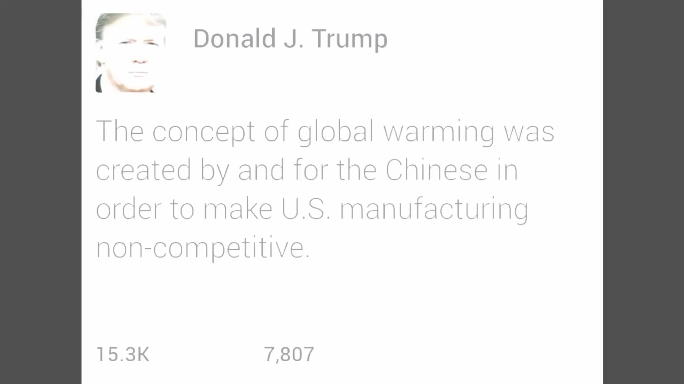
motivation
Climate Police | Abhishek Sugam | Yuanqi Mao | Giovanni Sinapi | SWEDS Fall ‘16

Slide 4
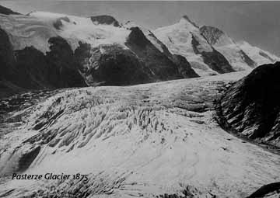
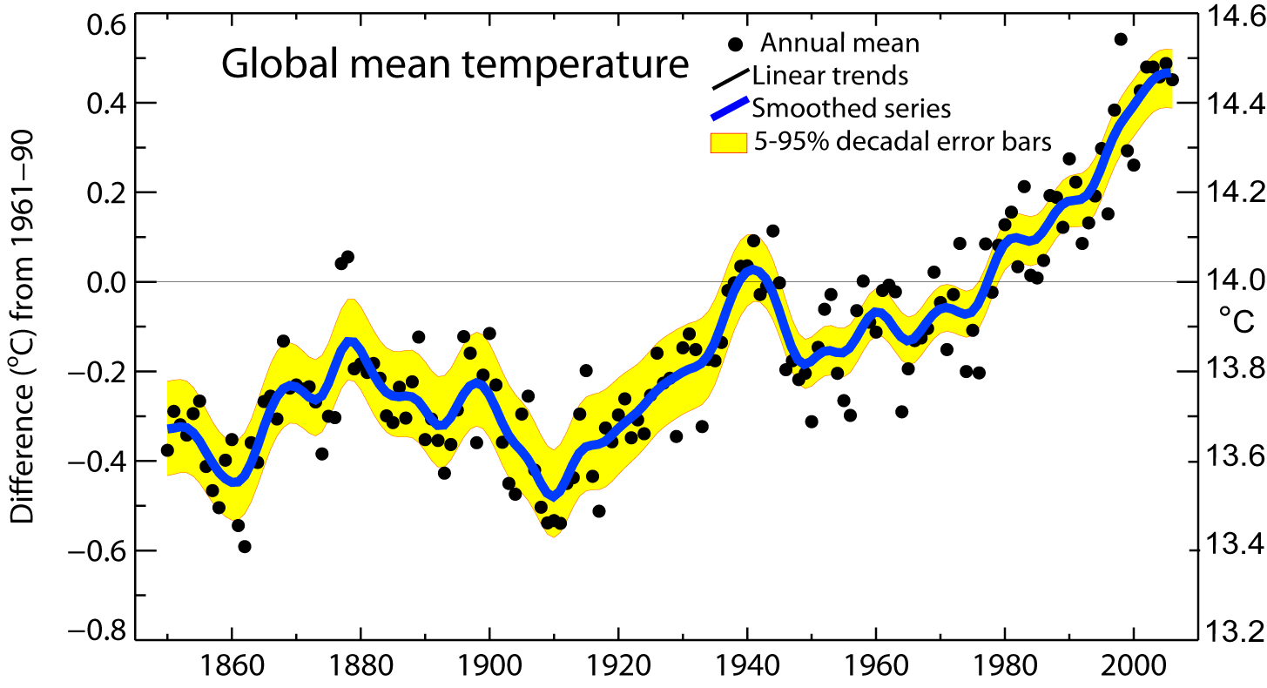
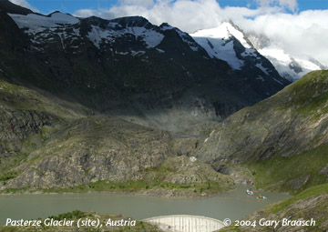
Global warming
Climate Police | Abhishek Sugam | Yuanqi Mao | Giovanni Sinapi | SWEDS Fall ‘16

Slide 5
Target Audience
Data journalists who can use the data to drive the point home
Convince the general public that Global Warming is real
Politicians do what people want them to do..
TRY to prove to President Elect that global warming is not a Chinese hoax.
Climate Police | Abhishek Sugam | Yuanqi Mao | Giovanni Sinapi | SWEDS Fall ‘16

Slide 6
DataSets
Global Land temperature data from Berkeley Earth
http://berkeleyearth.org/data/
Pollution Data from US EPA
https://aqsdr1.epa.gov/aqsweb/aqstmp/airdata/download_files.html
Climate Police | Abhishek Sugam | Yuanqi Mao | Giovanni Sinapi | SWEDS Fall ‘16

Slide 7





Packages
Numpy
Pandas
Jupyter
Matplotlib
Plotly
Seaborn
Climate Police | Abhishek Sugam | Yuanqi Mao | Giovanni Sinapi | SWEDS Fall ‘16

Slide 8
Temperature anAlysis
What is the average temperature of various countries ?
How has temperature of the planet changed over the years ?
How does temperature rise compare among developing & developed countries?
How does temperature rise compare among countries with more manufacturing plants ?
Does the trend in temperature rise translate all across the globe?
How has temperature changed in the United States over the year?
Is there a regional trend in temperature rise?
Climate Police | Abhishek Sugam | Yuanqi Mao | Giovanni Sinapi | SWEDS Fall ‘16

Slide 9
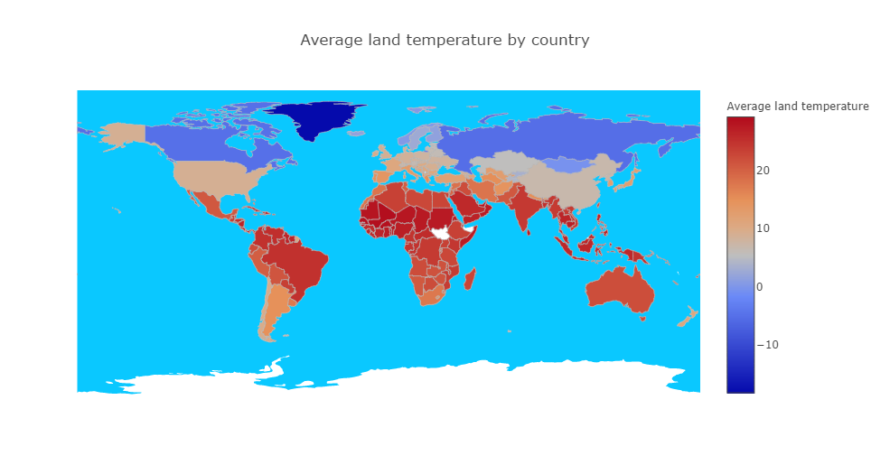
What is the average temperature of the countries?
Climate Police | Abhishek Sugam | Yuanqi Mao | Giovanni Sinapi | SWEDS Fall ‘16

Slide 10
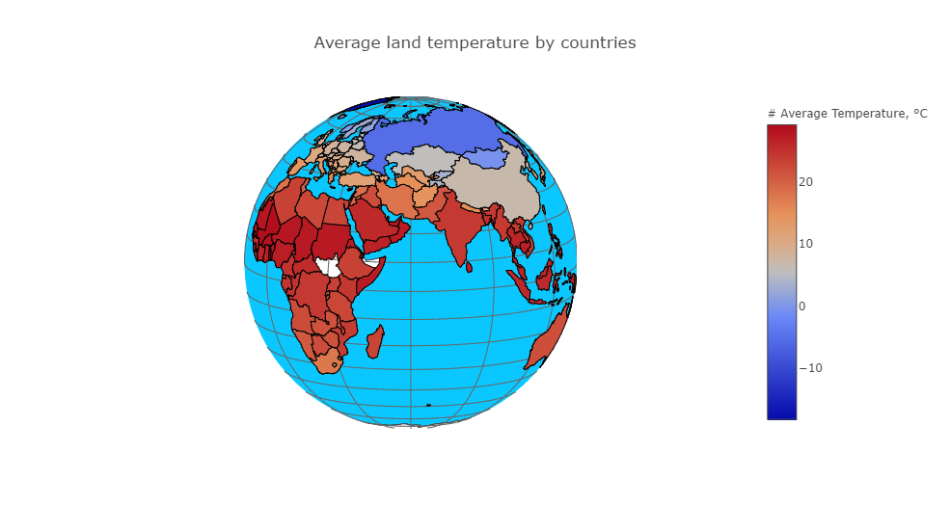
What is the average temperature of the countries?
Climate Police | Abhishek Sugam | Yuanqi Mao | Giovanni Sinapi | SWEDS Fall ‘16

Slide 11
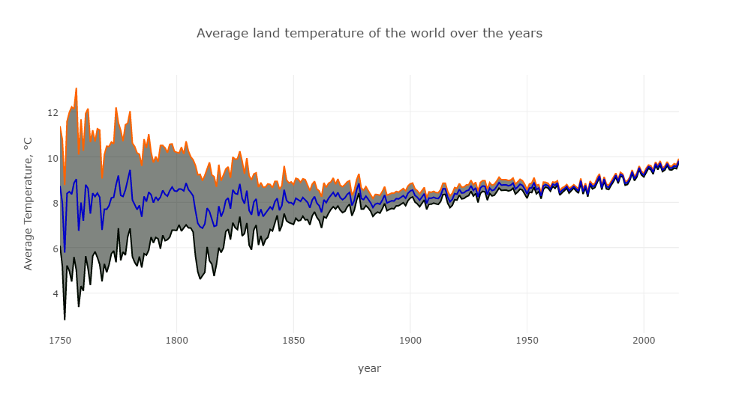
How has temperature of the planet changed over the years ?
Climate Police | Abhishek Sugam | Yuanqi Mao | Giovanni Sinapi | SWEDS Fall ‘16

Slide 12
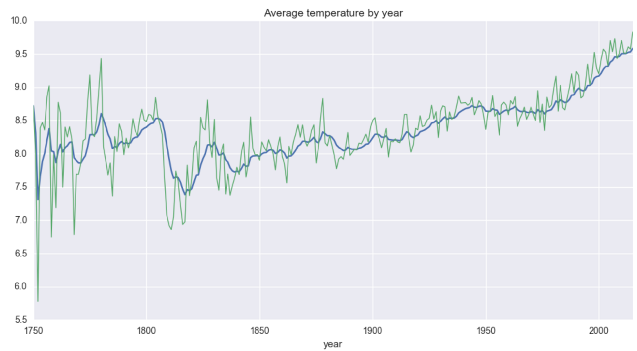
Temperature analysis
Climate Police | Abhishek Sugam | Yuanqi Mao | Giovanni Sinapi | SWEDS Fall ‘16

Slide 13
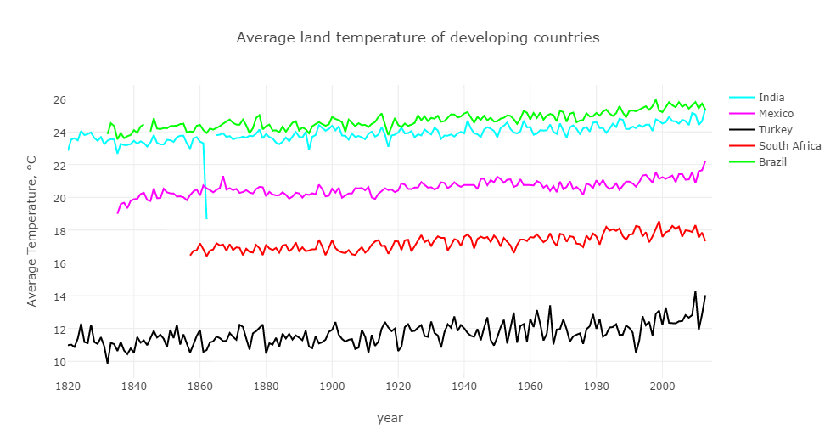
Temperature rise in developing countries
Climate Police | Abhishek Sugam | Yuanqi Mao | Giovanni Sinapi | SWEDS Fall ‘16

Slide 14
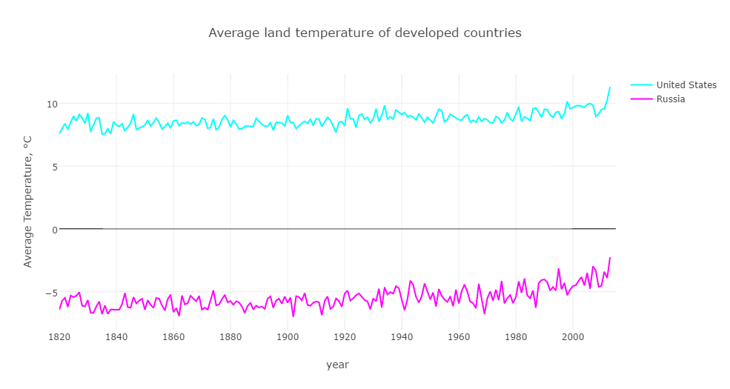
Temperature rise in developed countries
Climate Police | Abhishek Sugam | Yuanqi Mao | Giovanni Sinapi | SWEDS Fall ‘16

Slide 15
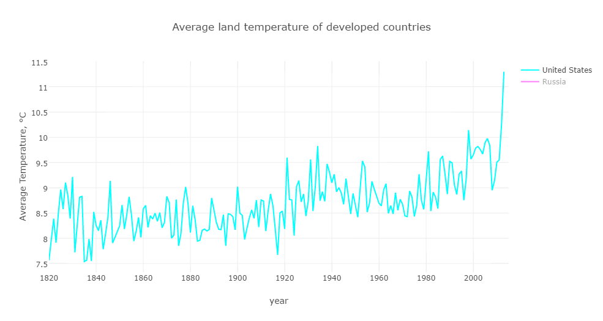
Temperature rise in developed countries
Climate Police | Abhishek Sugam | Yuanqi Mao | Giovanni Sinapi | SWEDS Fall ‘16

Slide 16
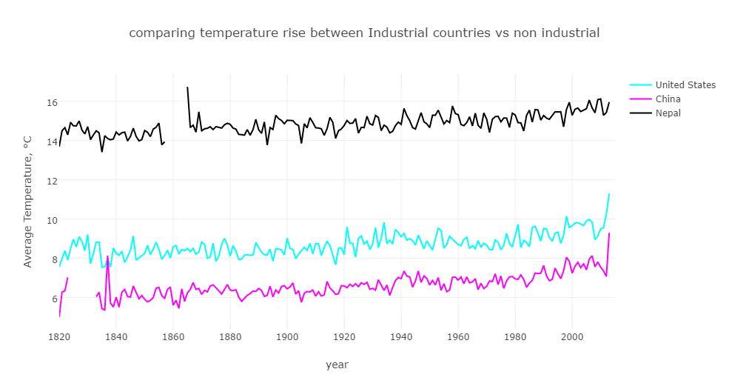
Temperature rise with more manufacturing
Climate Police | Abhishek Sugam | Yuanqi Mao | Giovanni Sinapi | SWEDS Fall ‘16

Slide 17
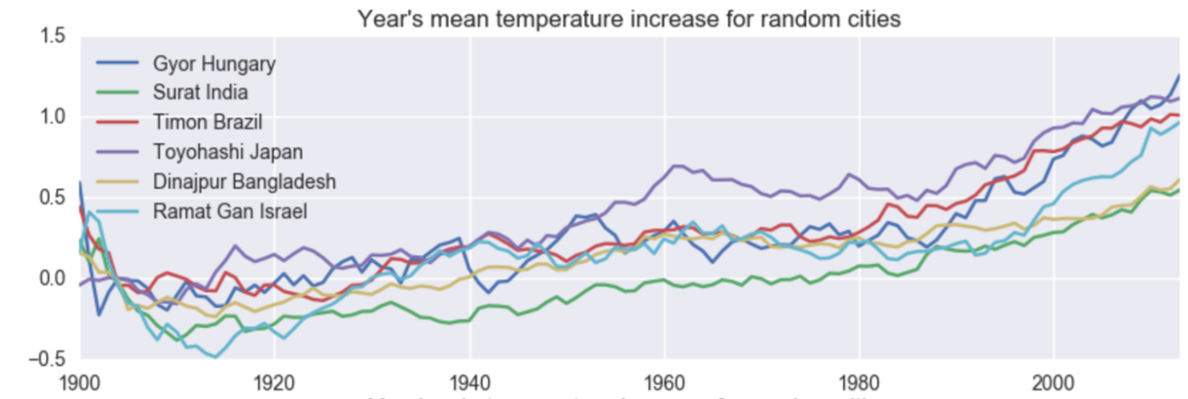
Does the trend in temperature rise translate all across the globe?
Climate Police | Abhishek Sugam | Yuanqi Mao | Giovanni Sinapi | SWEDS Fall ‘16

Slide 18
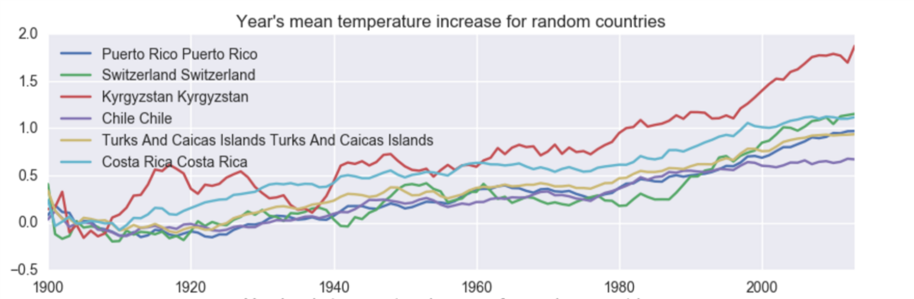
Does the trend in temperature rise translate all across the globe?
Climate Police | Abhishek Sugam | Yuanqi Mao | Giovanni Sinapi | SWEDS Fall ‘16

Slide 19
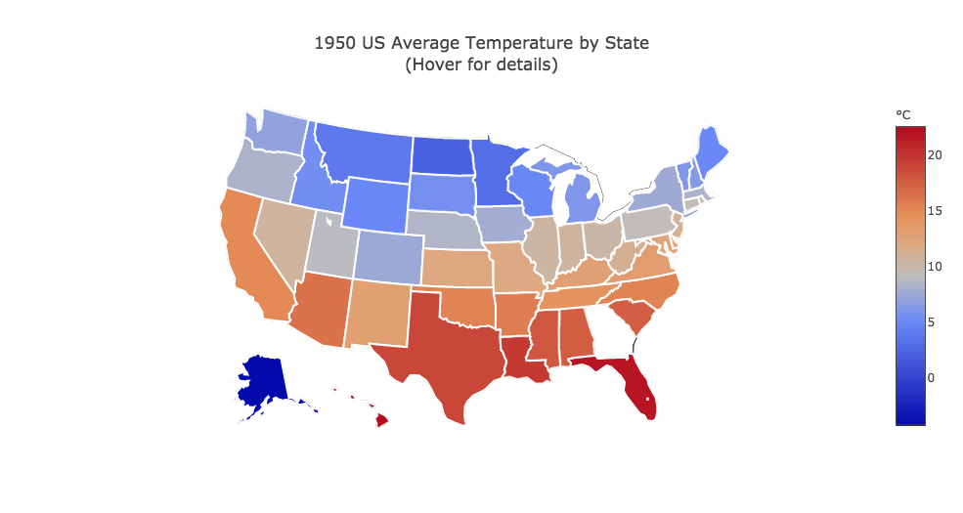
Temperature Analysis
Climate Police | Abhishek Sugam | Yuanqi Mao | Giovanni Sinapi | SWEDS Fall ‘16

Slide 20
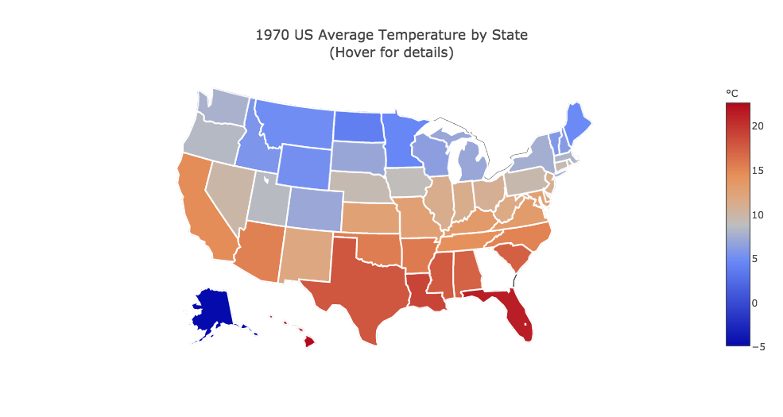
Temperature Analysis
Climate Police | Abhishek Sugam | Yuanqi Mao | Giovanni Sinapi | SWEDS Fall ‘16

Slide 21
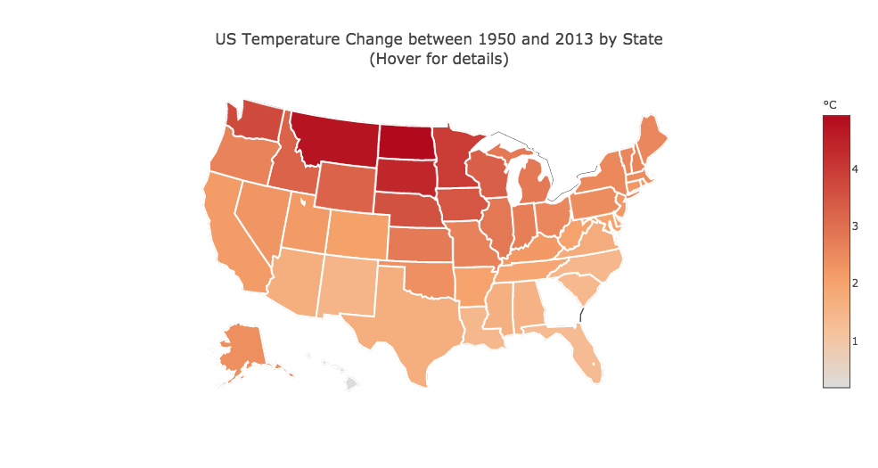
Temperature Analysis
Climate Police | Abhishek Sugam | Yuanqi Mao | Giovanni Sinapi | SWEDS Fall ‘16

Slide 22
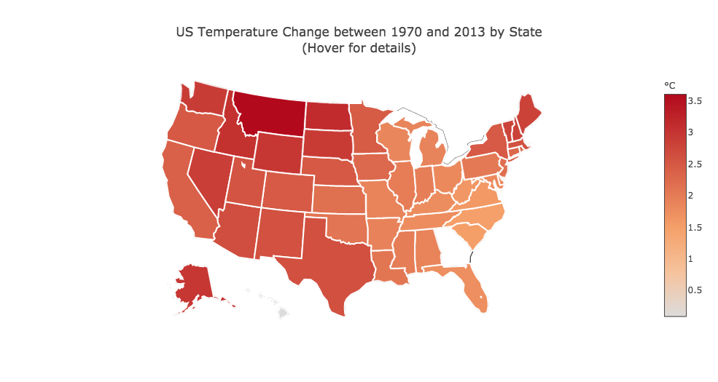
Temperature Analysis
Climate Police | Abhishek Sugam | Yuanqi Mao | Giovanni Sinapi | SWEDS Fall ‘16

Slide 23
Pollutant Analysis
What is the amount of pollutants in different states of the US?
How has the amount of pollutants change over the years?
Is there a regional trend to pollutant increase?
Climate Police | Abhishek Sugam | Yuanqi Mao | Giovanni Sinapi | SWEDS Fall ‘16

Slide 24
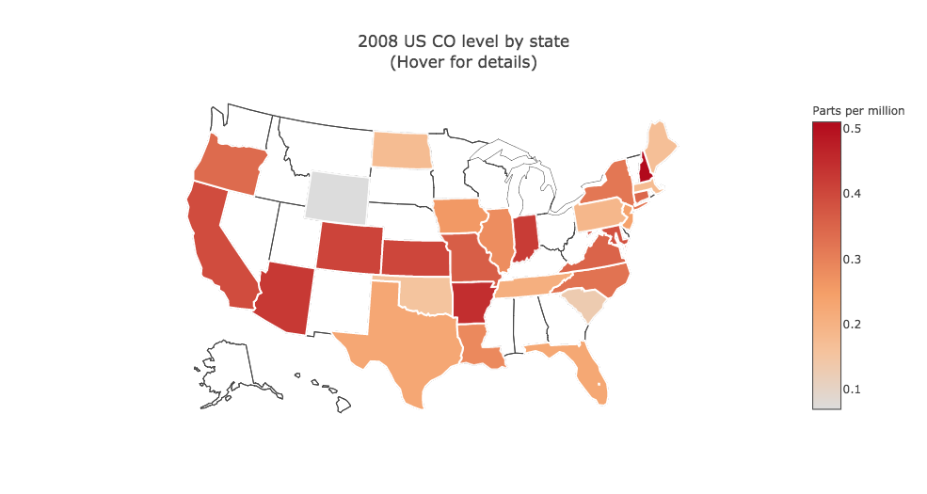
Pollutant level by state & year
Climate Police | Abhishek Sugam | Yuanqi Mao | Giovanni Sinapi | SWEDS Fall ‘16

Slide 25
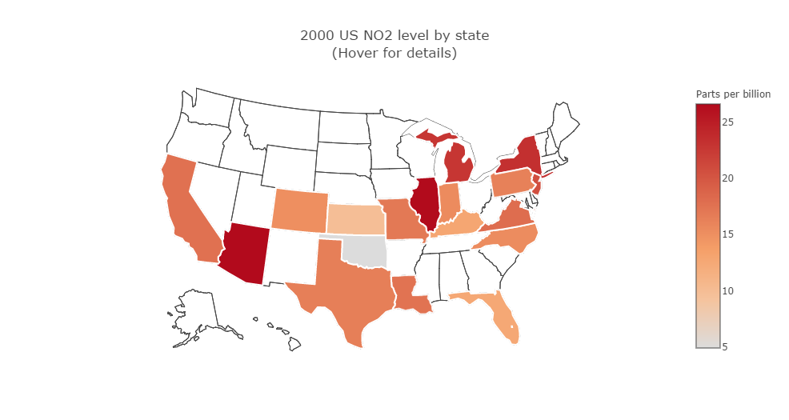
Pollutant level by state & year
Climate Police | Abhishek Sugam | Yuanqi Mao | Giovanni Sinapi | SWEDS Fall ‘16

Slide 26
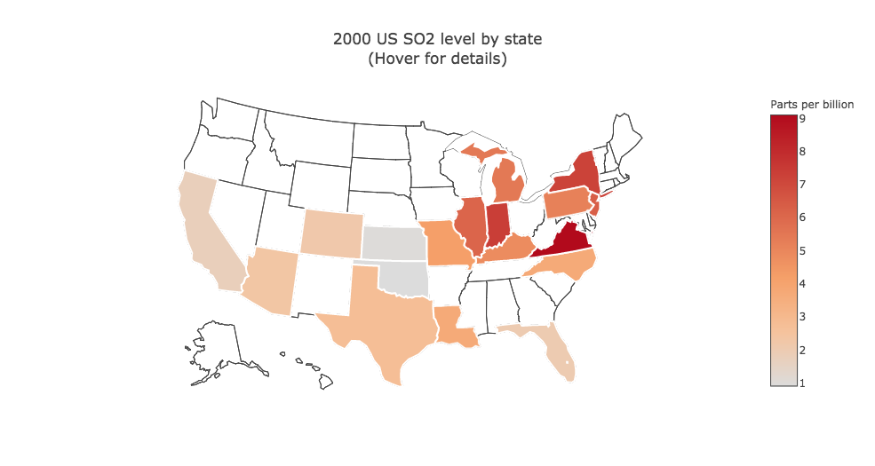
Pollutant level by state & year
Climate Police | Abhishek Sugam | Yuanqi Mao | Giovanni Sinapi | SWEDS Fall ‘16

Slide 27
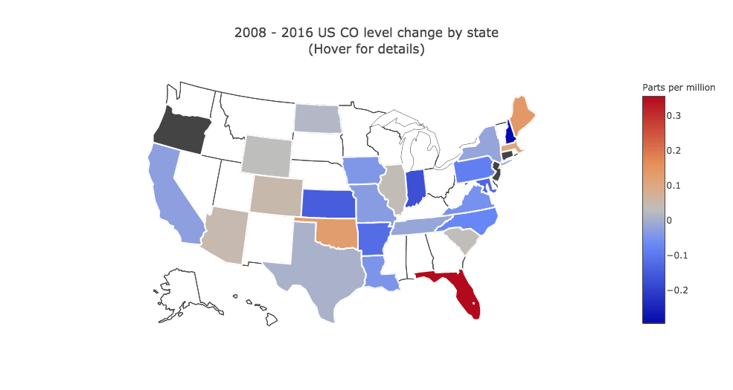
Pollutant change
Climate Police | Abhishek Sugam | Yuanqi Mao | Giovanni Sinapi | SWEDS Fall ‘16

Slide 28
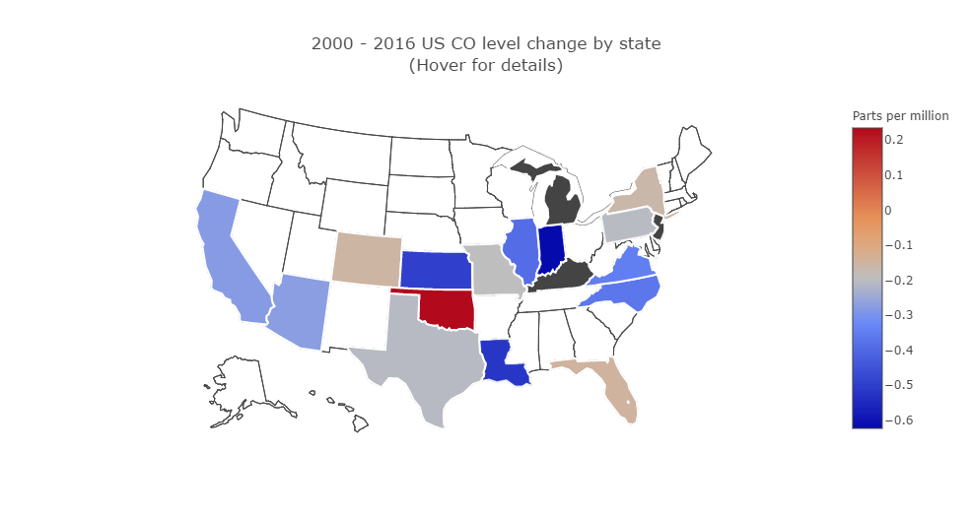
Pollutant change
Climate Police | Abhishek Sugam | Yuanqi Mao | Giovanni Sinapi | SWEDS Fall ‘16

Slide 29
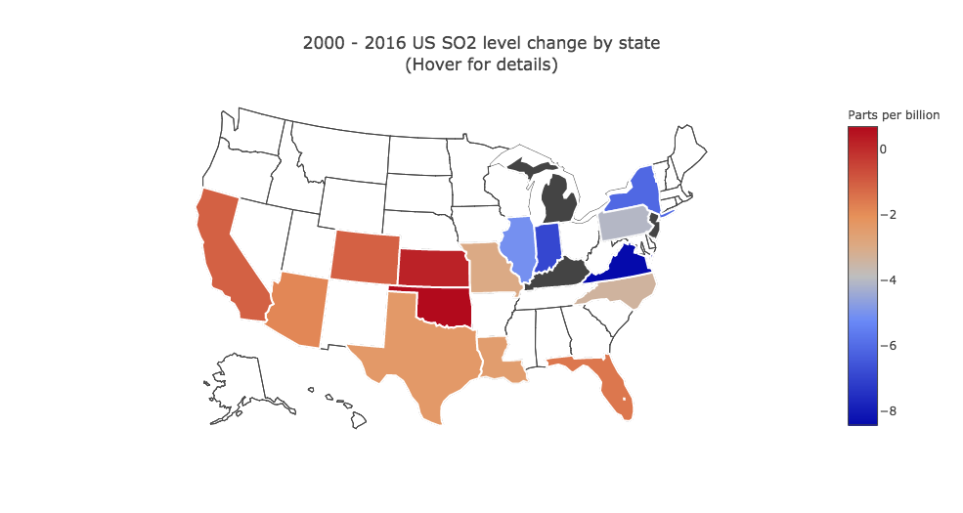
Pollutant change
Climate Police | Abhishek Sugam | Yuanqi Mao | Giovanni Sinapi | SWEDS Fall ‘16

Slide 30
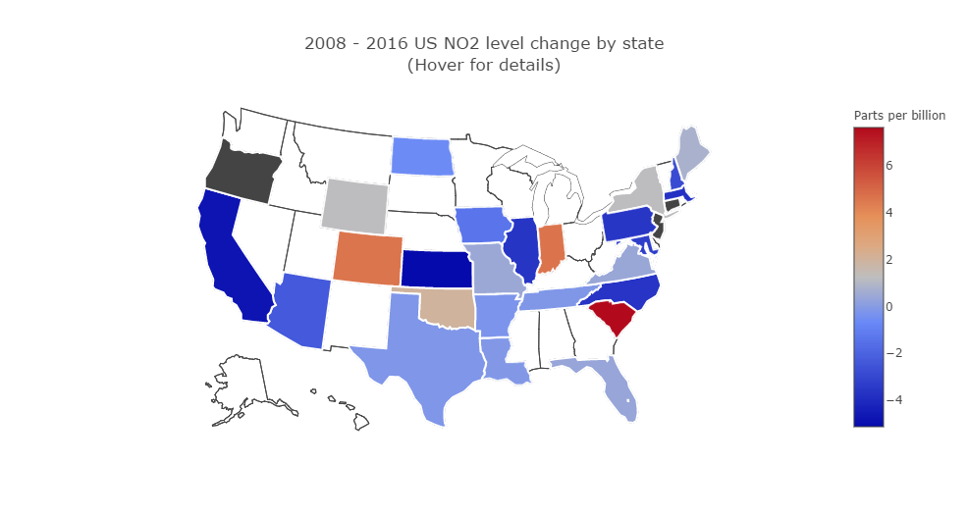
Pollutant Change
Climate Police | Abhishek Sugam | Yuanqi Mao | Giovanni Sinapi | SWEDS Fall ‘16

Slide 31
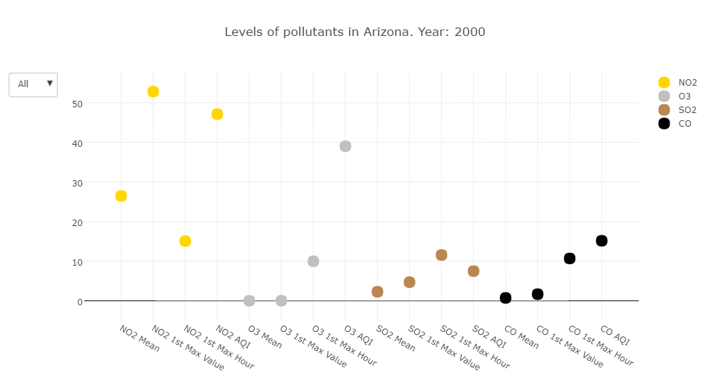
Pollutant Analysis
Climate Police | Abhishek Sugam | Yuanqi Mao | Giovanni Sinapi | SWEDS Fall ‘16

Slide 32
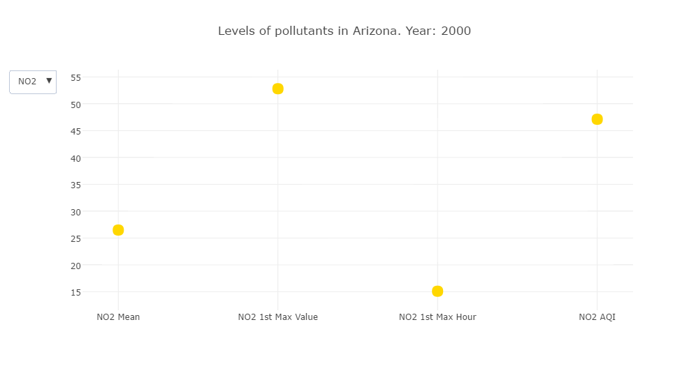
Pollutant Analysis
Climate Police | Abhishek Sugam | Yuanqi Mao | Giovanni Sinapi | SWEDS Fall ‘16

Slide 33
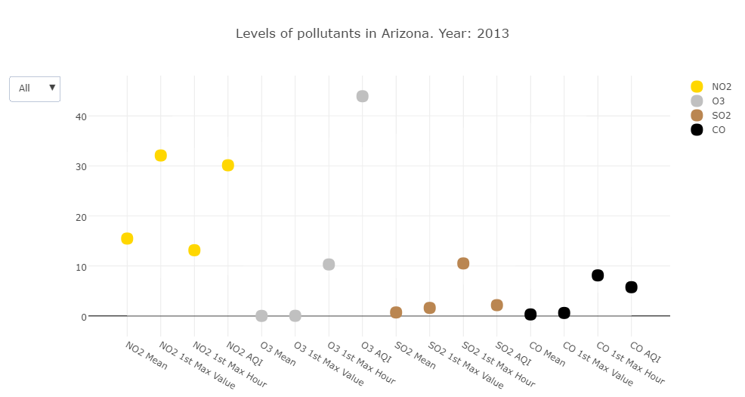
Pollutant Analysis
Climate Police | Abhishek Sugam | Yuanqi Mao | Giovanni Sinapi | SWEDS Fall ‘16

Slide 34
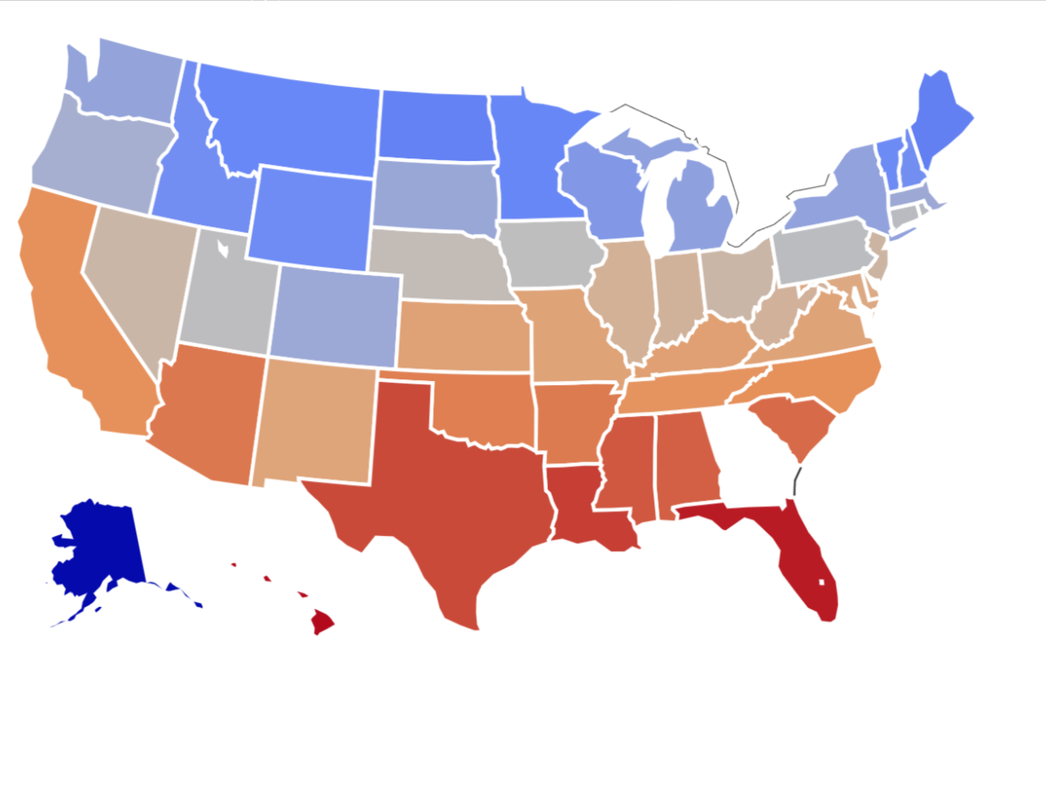
correlation
Temperature change b/w 2000-2013 CO level change b/w 2000-2013
Climate Police | Abhishek Sugam | Yuanqi Mao | Giovanni Sinapi | SWEDS Fall ‘16

Slide 35
correlation
Temperature change b/w 2000-2013 NO level change b/w 2000-2013
Climate Police | Abhishek Sugam | Yuanqi Mao | Giovanni Sinapi | SWEDS Fall ‘16

Slide 36
Thank you
Questions?
Climate Police | Abhishek Sugam | Yuanqi Mao | Giovanni Sinapi | SWEDS Fall ‘16

